Slide 1
Working with Rasters
Gregory Brunner

Slide 2
Things we can do with raster data
Display
List and Describe
Analysis – Spatial Analysis and Map Algebra
Raster Objects
Numpy arrays
Mosaic (we’ll cover this next week)

Slide 3
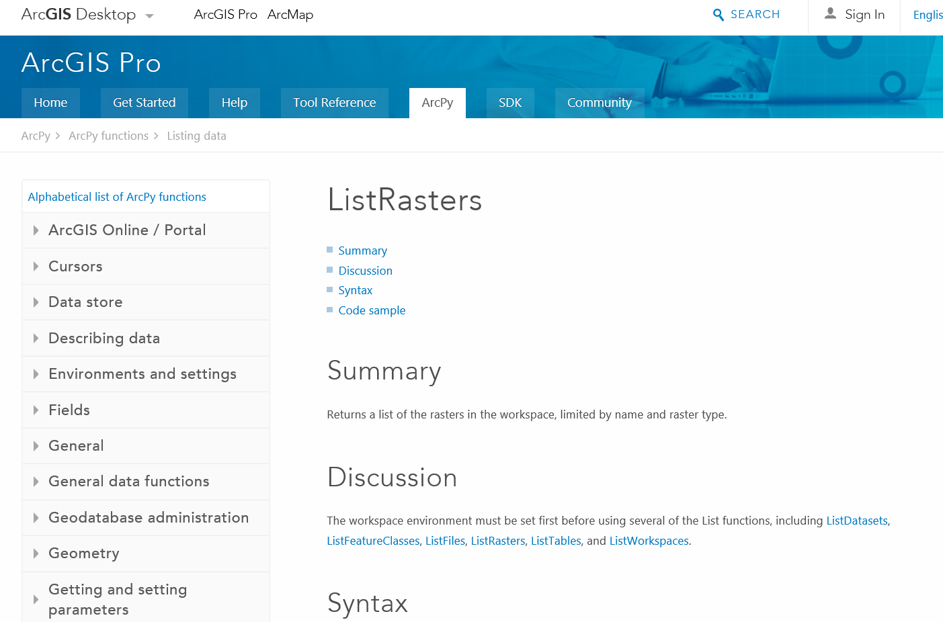
Listing Rasters

Slide 4
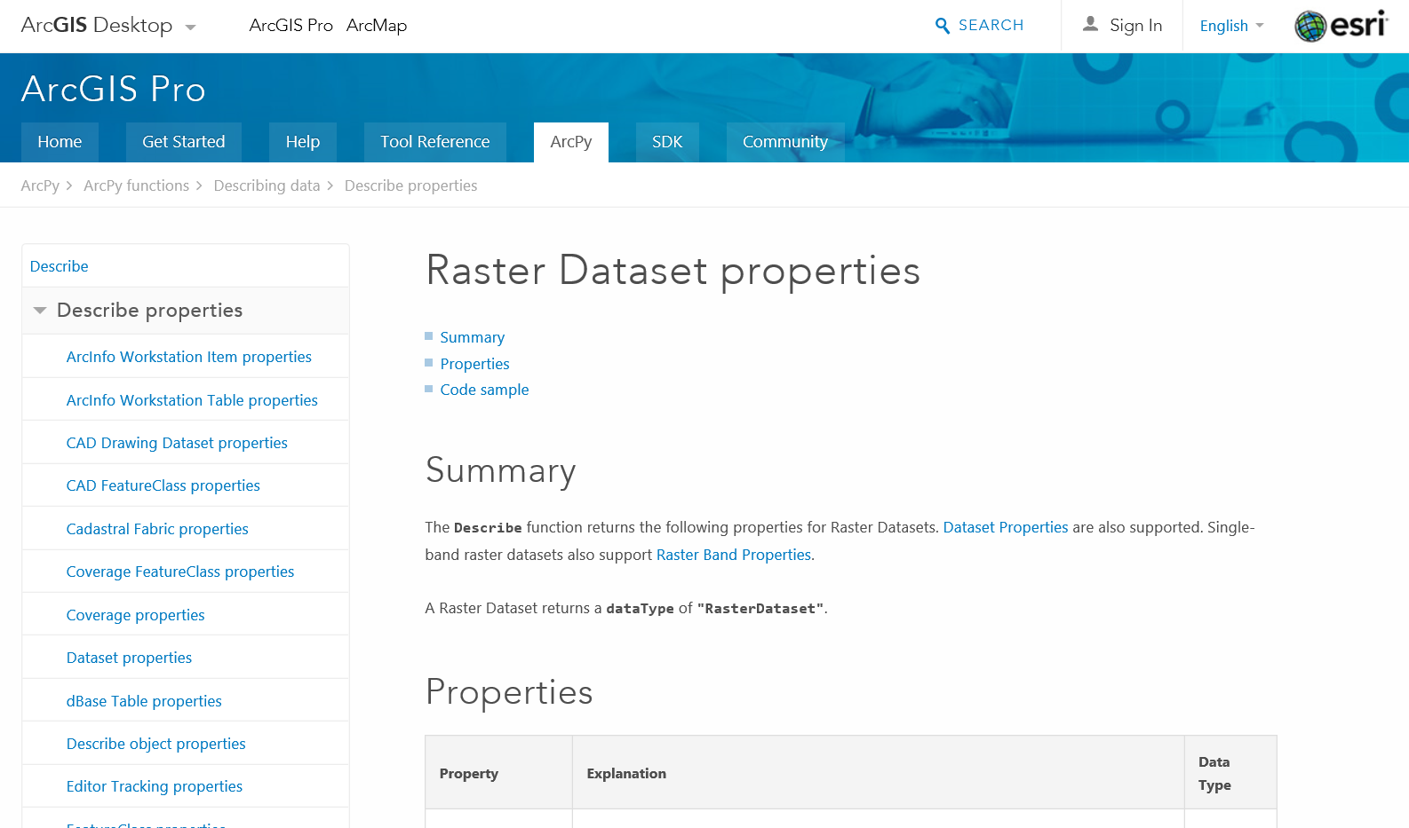
Describing Rasters

Slide 5
Analysis – Map Algebra
We can treat rasters as objects in Python
Simple and powerful algebraic expression through Spatial Analysis Tools
Available through Spatial Analysis module
Integrated into Python

Slide 6
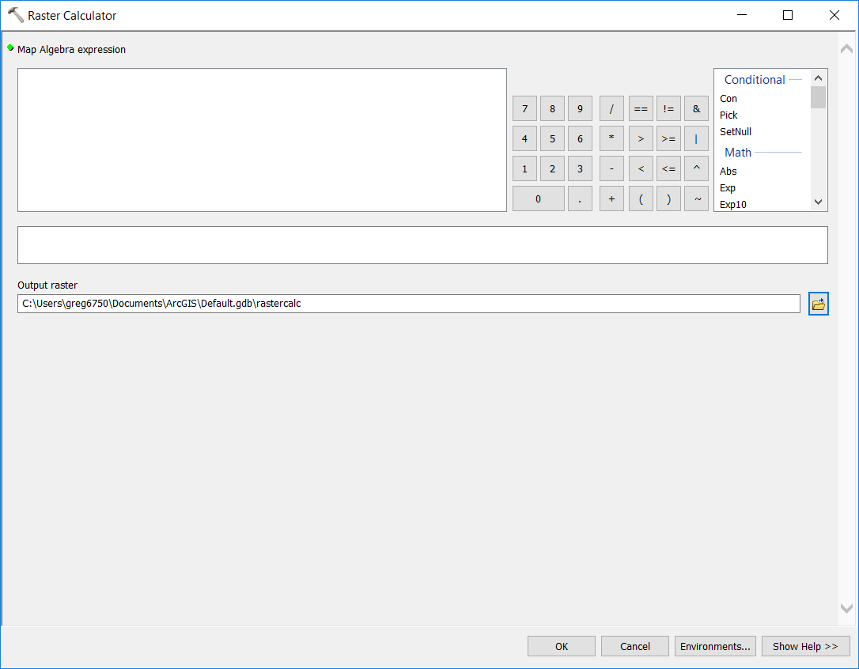
Ways to Access Map Algebra
Raster Calculator tool in ArcMap
Python Window
Python scripting

Slide 7
Importing Spatial Analyst Module
Module of Arcpy
Has to be imported
Best practice:
>> import arcpy
>> from arcpy.sa import *
Do not do:
>> import arcpy.sa

Slide 8
Syntax
>> from arcpy.sa import *
>> inDem = r”C:\Student\elevation.tif”
>> slopeRas = Slope(inDem)
>> slopeRas.save(r”C:\Student\slope.tif”)

Slide 9
Demo: List and Process Rasters

Slide 10
Demo: Raster Processing with Numpy

Slide 11
Project and In-Class work
Submit in-class work to Week 9 folder
Project 2 is in Projects folder – Due Tuesday 4/4

